Slide 1
Data Requests
Patrick Mathias
DLMP Core

Slide 2
Lesson Goals
Understand the considerations and limitations of laboratory data requests
Use local resources to develop and complete a data request
Lesson Objectives
Describe the common stages of completing a data request
List the minimum requirements for a good data request
Formulate a data request for an analysis project
Notes:
In the second session we will learn some fundamentals of coding including using functions, creating objects, and importing data.

Slide 3
Data analysis in the laboratory
Clinical laboratories produce highly useful data, including:
Clinical order-related data
Testing parameters
Test-associated demographics
Clinical diagnostic data

Slide 4
Data analysis in the laboratory
The data generated by LIS and EHR systems and ancillary applications is stored in databases. Structured queries are needed to access the data with:
Extraction
Manipulation
Analysis
Whether data can be accessed (or how easy it will be) may be determined by the structure and standardization of the database(s)-
“tidy” data facilitates nimble queries
Notes:
Notes: If not too duplicative of where covered elsewhere, could create a simple visual like the one in this blog to show to explain tidy data: https://medium.com/@ArjunThoughts/datascience-simplified-tidy-data-3c6dbabab0b2

Slide 5
Data extraction takes many forms
Clinical information system reports: less flexible
Static, pre-built reports
Configurable
Self-service analytics tools: user flexibility in selecting from a range of fixed data elements
Data warehouse: highly flexible access to broad data typically requiring structured query language
May require an analyst or special training for access
Regardless of how the extraction is performed, formulating a data request (or specification) is the first step!

Slide 6
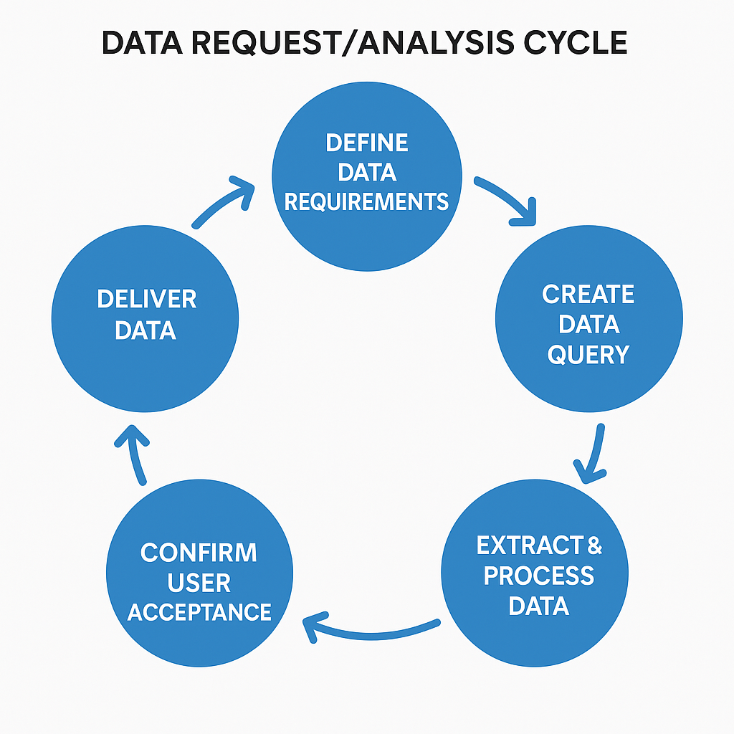
Typical stages of a data analysis request
Process is usually not linear!
May require multiple iterations to complete
May be an ongoing cycle (for ongoing data needs)
Roles of those involved in the data request: analysts, requesters, end users
Notes:
image created with chat gpt

Slide 7
Timeline planning
Expected timeline can vary based on:
Governance processes (getting access to data
Analyst availability/resources
Often overlooked: availability of data requester and/or end users whose input is needed for requirements and validation
Notes:
image created with chat gpt

Slide 8
Defining Requirements

Slide 9
Make a request with the end in mind
By working backwards from the final product you will decrease the number of cycles of iteration for extracting or requesting data:
What data question(s) is being asked
Who are the end users of the data?
How the extracted data will be used (daily operations, research, etc.?)
Where and how the data will be accessed once delivered

Slide 10
Minimum requirements of a data request
Data requests should always include variables of interest and inclusion criteria (specific observations): Write this out in plain language ahead of time even if you are retrieving data yourself!
From where is the data sourced?
Which records will be extracted?
Which data attributes (fields, columns) are needed?
Inclusion/exclusion criteria (date ranges, patient age, locations)
Notes:
Consider tidy data call out here
Extracting data requires translating a question in human-readable words into a database query (typically an SQL query) or configuring filters and settings in a self-service query tool (like a business intelligence application)

Slide 11
Working with analysts
Data analysts and end users may initially be “siloed”
Analysts working with lab data may not have lab domain knowledge
Examples of topics not intuitive to those outside lab:
Sequence and significance of time stamps (accession, collection, result times)
Instrument-dependent workflows that influence data
Lab accreditation/regulatory-related parameters
Notes:
Examples of intuitive field to lab users not being so to analysts

Slide 12
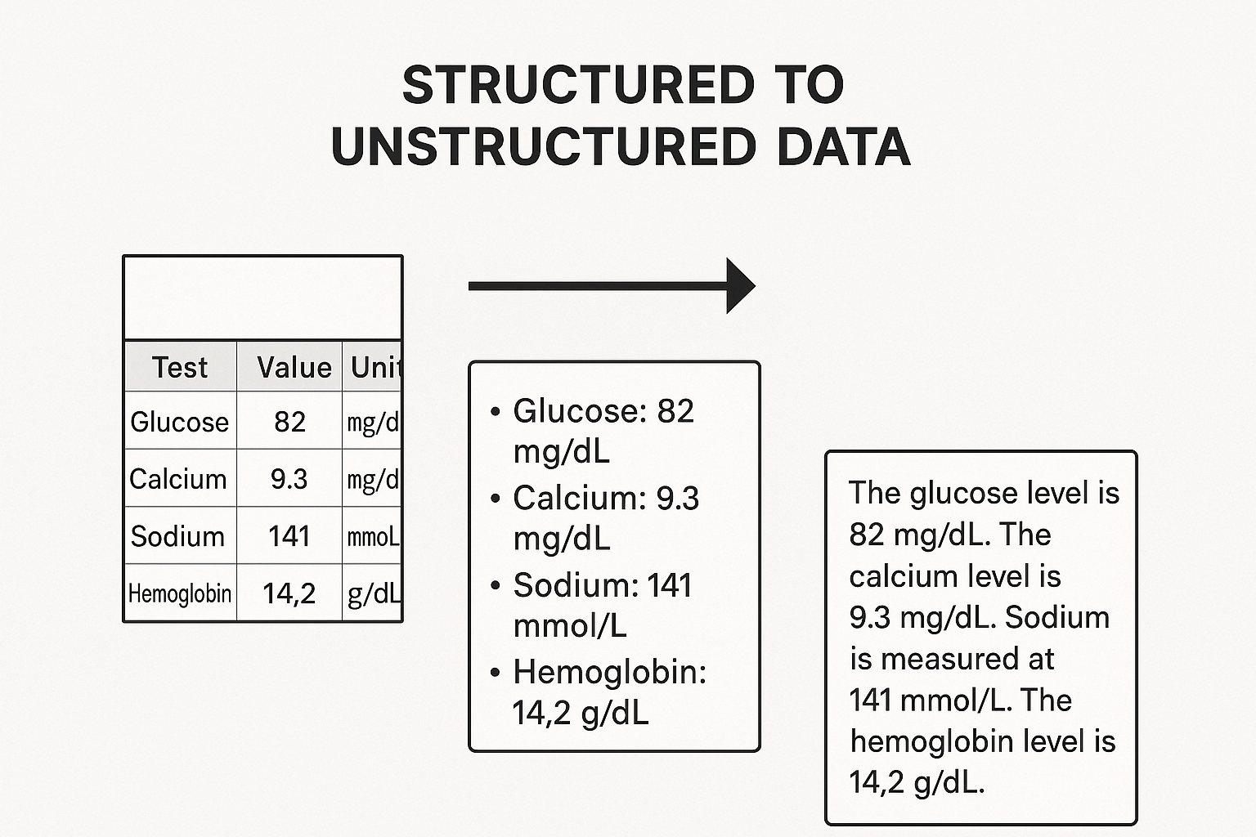
Data limitations: structured vs. unstructured data
“Structuredness” of data refers to degree of data organization in consistent, predefined format
Laboratory data ranges from highly structured to unstructured
Notes:
Tidy data is covered in module 3 so can add here or not- PCM referenced a visual in presentation. Might be helpful
image generated with chat gpt- can refine this visual and label if needed

Slide 13
Developing a Request

Slide 14
Establish a shared understanding of data purpose between requestor and analyst:
Do you plan to use this data to solve a problem?
Do you plan to develop this into a research project (so will need IRB?)
Is this likely to be a one time request or an ongoing data need?

Slide 15
Make a request with the end in mind
By working backwards from the final product you will decrease the number of cycles of iteration for extracting or requesting data:
What data question(s) is being asked
Who are the end users of the data?
How will the extracted data be used (daily operations, research, etc.?)
Is data manipulation or transformation needed?
Where and how the data will be accessed once delivered
Next several slides: a series of questions and answers will define additional specifics needed for data extraction

Slide 16
Example case: developing a data query
You are part of a quality improvement (QI) group in the hospital that want to improve adherence to medical guidelines in testing and treatment of streptococcal infections in patients visiting the emergency department. You are interested in understanding:
“How is strep testing used in our hospital’s emergency department for diagnosing streptococcal pharyngitis?”

Slide 17
Q: Who is the end user(s) of the data?
Considerations:
How many users: one, a few, many?
What is the data literacy level of the user(s)?
Role of the users:
Internal to the organization, external, or a mix?
Clinical, non-clinical, or both?

Slide 18
A: Small group of hospital-based users
You and several other members of your QI group will want to access the data:
All of you are hospital employees
None of you have extensive experience working with data directly (extracting, manipulating, or formatting data)
All of you frequently do access and review aggregated data as part of daily work

Slide 19
Q: How will the extracted data be used?
Will this data be used for:
Monitoring current state?
Identifying operational improvements (changing practice workflows?)
Research?
Patient care decisions?
Regulatory requirements?
Data can be multi-use, but it may become challenging to create a single data extract or report that can meet all needs.

Slide 20
A: One-time report for QI purposes
Your group wants to understand the current state and identify areas to improve the current streptococcal test ordering workflow.
You want to request a one-time report to be used for analysis of current data.

Slide 21
Q: How will the data be accessed?
Considerations:
Appropriate access: should users view confidential or protected health information if that is included in the data?
Frequency: is one-time, periodic, or on-demand access needed?
Will the users be expected to view only, or manipulate the data?
Does data need to be downloaded or shared outside the data delivery system?

Slide 22
A: Users need to access shared folder
Your small group of QI users all have access to the protected health information-compliant shared file storage used for hospital operations work.
You would like to be able to have the report stored and accessible there to users with the appropriate access- you will not need to download the data.

Slide 23
Q: What records will be extracted?
Let’s refine the draft question to translate into a data query:
“How is strep testing used in our hospital?”
May be important to specify the source database(s) (e.g. EHR operational database or curated research database)
Different databases are intended for specific uses and may contain different data and/or differently formatted data
Consideration: What does “used” translate into within the EHR? Do you mean who orders the test? Or who receives the results and makes subsequent medication decisions?

Slide 24
A: Electronic health record (EHR) data
You decide you are interested in understanding who places orders for strep tests in your EHR
Once the correct source is confirmed, from which database tables is the data being retrieved?
Lab test order details (such as the ordering user ID in the EHR) are stored in a data table called “Orders”
Clinical role details (user clinical role like attending physician, physician assistant, medical resident etc.) is in a table called “Credentials”

Slide 25
Q: Which data attributes are needed?
Attributes (or variables) are components of data observations and may include values or labels. Lab test-related data often includes attributes related to:
Patients: patient ID or medical record number (MRN)
Times/Dates: patient date of birth, order date, specimen collection time/date
Electronic health record user: ordering user, technologist finalizing test results
Location: performing laboratory, phlebotomy site
Laboratory or pathology tests: interpreting pathologist, result values, reference intervals

Slide 26
A: Characteristics of tests in the EHR
You decide you want to know what proportion of orders placed by each role turn out to detect antigen (are positive). You want to extract:
Patient name, patient ID, and patient date of birth
Test name and test ID code
Order ID (unique for each order)
Order location (hospital department where the order occurs)
Order user (ID of EHR user placing the order)
Test ordering, collection, and result times/dates
Test result (positive, negative, indeterminate)

Slide 27
Q: What are the inclusion/exclusion criteria?
Continue refining the data query:
“How many orders for strep testing in our hospital are placed by different user roles? Considerations:
Are you interested in “rapid” antigen screening (in your system these are EHR test codes ID LAB123 or LAB456, depending on location), throat swab for PCR (LAB789), throat culture (LAB1011), or some combination of the above?
Are you interested in specific populations by age, sex, or other demographics?
Do you want to include data for the entire organization, or a single location? What about the emergency departments vs. outpatient clinics?
What time period are you interested in? The past month? A recent entire year?

Slide 28
A: Roles ordering pediatric ED tests
You decide you are interested in characterizing orders:
Placed by different roles (attending physician, physician assistant, medical residents)
For all rapid antigen screening tests performed for patients <18 years
In all emergency departments (which have their own separate login in the EHR for orders)
Within the last 30 days

Slide 29
Q: Is data manipulation needed?
Your data query continues to evolve:
“What proportion of results ordered by each role (attending physician, physician assistant, and medical residents) for rapid antigen strep screening on patients younger than 18 at time of testing in all emergency departments are positive?”
Is data aggregation or manipulation needed?
Will you combine data from similar test methods at different sites? LAB123 and LAB456 are the same method but have different test codes in your system for historical reasons.
Do you need to normalize different result formats to be able to use them together? For example, a test at one site is resulted as “Positive” while another site uses “Reactive” for antigen results.
Notes:
Transformation (cleanup, aggregation) and statistical analysis

Slide 30
A: Yes
You decide you want to combine results from LAB123 and LAB111, and that you want to normalize the results to express a proportion of tests ordered by each role where the outcome is expressed as “Positive” if antigen is detected and “Negative” if not detected.
Notes:
Transformation (cleanup, aggregation) and statistical analysis

Slide 31
Q: What will the end deliverable look like?
You and the analyst feel that the data query is detailed enough to begin extraction:
“Visualize the proportions of positive and negative results for all LAB123 and LAB111 tests combined, ordered on patients younger than 18 at time of testing, by role (attending physician, physician assistants, and medical residents, respectively) in all emergency departments”
What will the structure of the answer be?
list summary?
table?
graph?
A: In this case, you request a table to summarize and visualize the data easily
Notes:
Can make a representative series of 3 pie charts

Slide 32
Data Extraction and Validation

Slide 33
Data extraction
The data analyst(s) will gather and prepare data for review. This involves:
Data retrieval from database(s)
Data transformation (cleanup to remove duplicates or irrelevant data, converting to usable format)
Data loading to a folder or application accessible by the end user

Slide 34
Validation
Validation is the process of verifying data accuracy by assessing:
Integrity: e.g. ensure data is not duplicated
Consistency: is the data in expected format and sequence
Presence: is there missing data?
Validation approach may vary in extent, and may be automated and/or manual depending on situation. Even where automated, it is always a good idea to at least briefly review raw data.
Notes:
Call out responsibility/role of data requestor/end user in being involved with validation

Slide 35
Example
You work with an analyst, who creates a one-time SQL extract to analyze the two rapid strep test codes from your QI query
The analyst provides a preliminary raw data extract to review. You note:
The extract displays each test ordered in a separate row, and there are about 1200 rows in total
However, you suspect from your experience with ED volumes that the system volume of the test should be higher.
How would you validate these findings?
Notes:
You know that your volume should be much higher than that

Slide 36
Example: Validation, con’t
Very important: often the information needed to validate is not found within the data extract itself, but may rely on domain experts who use and know the sources of the data (in this case lab users familiar with the EHR)
Are there other complementary sources of data?
EHR or LIS tools, e.g. Epic Slicer Dicer
QI reports used by other teams

Slide 37
Requesting Data from DLMP Informatics

Slide 38
Local Data Resources
DLMP Data Warehouse
SQ Lab detailed data beyond orders and results – transactional events tied to movement of samples and testing activities
AP Beaker data derived from Epic Clarity – result/report data + selected transactional data
Data Innovations – select instrument transactional data (e.g. Ct values from some instruments)
Xifin – financial data for reference lab activities
Selected, frequently used data from UW Medicine DAWG enterprise data warehouse
Trainees can be onboarded and granted access – requires use of SQL and time investment
UW Medicine Data Analytics Warehouse Galaxy (DAWG)
Selected Epic Clarity tables – relational database representation of Epic Chronicles (production database)
Legacy data from retired systems, e.g. Cerner

Slide 39
Pathways to Access Data
Epic Slicer Dicer broadly available for self-service
Best for population level queries and generating counts of patients meeting inclusion criteria
Row level data can be extracted with appropriate privacy training
Can be limited for lab questions that require more granular details
DLMP Tallies Dashboard: https://tallies.labmed.uw.edu/
Test volumes and basic turnaround times for lab med tests
Data extracted and aggregated from SQ Lab daily
Data request to DLMP Analytics team
Dedicated team of ~2.5 FTE completing operational/QI and research data requests
Access to DLMP Data Warehouse, DAWG, and Epic reporting tools (e.g. Reporting Workbench)

Slide 40
Data Need
No
Research?
Yes
Operational/QI Request Form
Yes
Blanket IRB?
No
Review by Compliance Officer
DLMP Analytics
Review by RTS Director
RTS Request Form

Slide 41
Operational Data Requests
https://bit.ly/dlmp-ops-data
Must attest that the data will not be used for research purposes – but can be converted into blanket IRB
Short description of project
Short description of requested data – list of common variables at https://kb.labmed.uw.edu/display/HOME/Data+Dictionary+for+Data+Requests

Slide 42
Research Requests Under Blanket IRB
Blanket IRB is used for studies not funded by an external grant that are retrospective in nature and only require data from electronic systems
Requests can be made through operational request form – but make a note that there is intent to use the blanket IRB
Training and sign off on blanket IRB access is required
When specific charts are reviewed as part of the research, this should be recorded on the Accounting of Disclosures form and submitted

Slide 43
Other Research Requests
Other research requests that are focused on lab/path data can be submitted to Research Testing Services: https://redcap.link/DLMPResearchDataRequestForm
For studies that have their own IRB – typically externally funded studies or those that have requirements beyond data
Review ensures that the scope of data requested aligns with the IRB documentation

Slide 44
Apply the Tidy Data Framework When Requesting Data
Consider which variables (data elements) you will need for your data request
Then determine how a data analyst will know which observations will be included
Inclusion criteria – how will you go from a whole population to a subpopulation?
Common criteria: specific orders, specific test values, age range, set of locations
Lab data often already stored in a tidy data format

Slide 45
Tips for Generating Your Own Data

Slide 46
Building your own data set
Data analysis projects beyond a certain complexity require creating your own variables or data frames (tables/spreadsheets)
In addition to building tidy data sets, consider steps to make future analysis easier

Slide 47
Naming Variables
Use variable (column) names that are easy for someone not performing your analysis to understand
“result_value” as opposed to “x”
“collection_time” instead of “time”
Stick to naming that will make it easier for a computer to read the data
Avoid spaces in names: “result_value” instead of “result value” (space has meaning in languages like R)
All lowercase (or uppercase) will be easier for you to type, even if it is not easier for the computer to parse

Slide 48
Respect Data Types When Creating Variables
Variable inspection and summarization is much easier (and less error prone) if known data types are used
run_id | value
1 | 5
2 | cancelled
3 | 11
4 | < 2
5 | 4
run_id | value | comment
1 | 5
2 |  | cancelled
3 | 11
4 |  | < 2
5 | 4

Slide 49
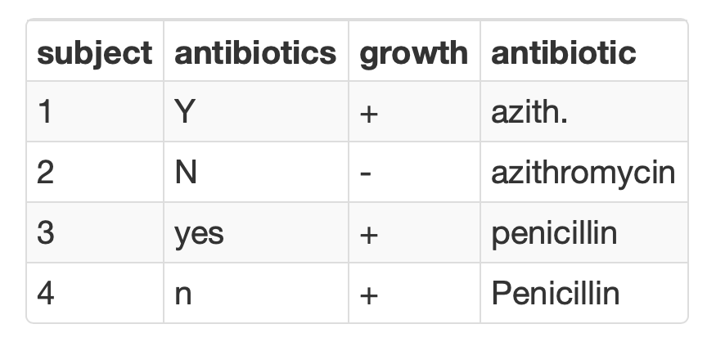
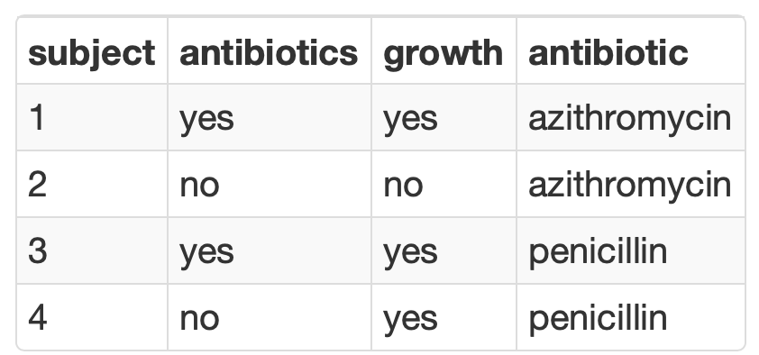
Consistency is Critical for Analyzing Categorical Variables
Summarization is seamless when consistent values are used to represent binary or categorical variables

Slide 50
Use Standard Formats for Dates and Times
Know and love the ISO 8601 standard for representing dates and times
Prevent ambiguity when interpreting and parsing
Dates in filenames sort chronologically
Excel unfortunately does not encourage the use of this format (but should parse it without a problem)
Obligatory xkcd (https://xkcd.com/1179/)

Slide 51
Securing Your Data

Slide 52
UW Medicine Privacy, Confidentiality, and Information Security Agreement
All UW Medicine workforce members (including faculty, employees, trainees, volunteers, and other persons who perform work for UW Medicine) are personally responsible for ensuring the privacy and security of all patient, confidential, restricted, research data, student information or proprietary information to which they are given access (referred to throughout this document as protected information).

Slide 53
Keep protected information confidential
PCISA: I will maintain the confidentiality of all protected information that I have access to.
Protected (health) information = personally identifiable information + health information
Best practice: assume all info is protected unless proven otherwise!
Name | Address (< state) | Dates (birth, service, etc.) < year*
Telephone numbers | Fax numbers | Email addresses
Soc sec number | MRN | Health plan number
Account numbers | License or cert. number | Vehicle identifiers
Device identifiers | Web URLs | IP addresses
Finger/voiceprints & recordings | Photographs | Any other unique ID
*No age in years if > 89

Slide 54
Only access systems as necessary to do your job
PCISA: I will only access UW Medicine clinical systems to perform my authorized job duties and will only use my own usernames and passwords. I am accountable for all accesses made under my login and password.
Authorization required to access PHI of family members (OK to access own PHI)
Don’t forward protected info to unapproved email domains: https://depts.washington.edu/uwmedsec/restricted/guidance/encryption/approved-email-domains/
Fred Hutch, Bloodworks NW, most (but not all) regional reference lab clients/local health systems
Secure email portal available when communication with outside entity that includes PHI is required

Slide 55
Use the necessary technical tools to protect data
PCISA: I will store all protected information on secured systems, encrypted mobile devices, approved third party applications or other secure media.
PCISA: I will ensure that my personally-owned computing devices are secured according to UW Medicine’s information security requirements before using them to perform UW Medicine business operations.
Use DLMP provided workstations, laptops, and computing resources for work activities
Password protect and encrypt any personal devices that may hold PHI
Connect to VPN when completing work activities, especially remotely
labmedhelp@uw.edu for help with encryption of a personal device

Slide 56
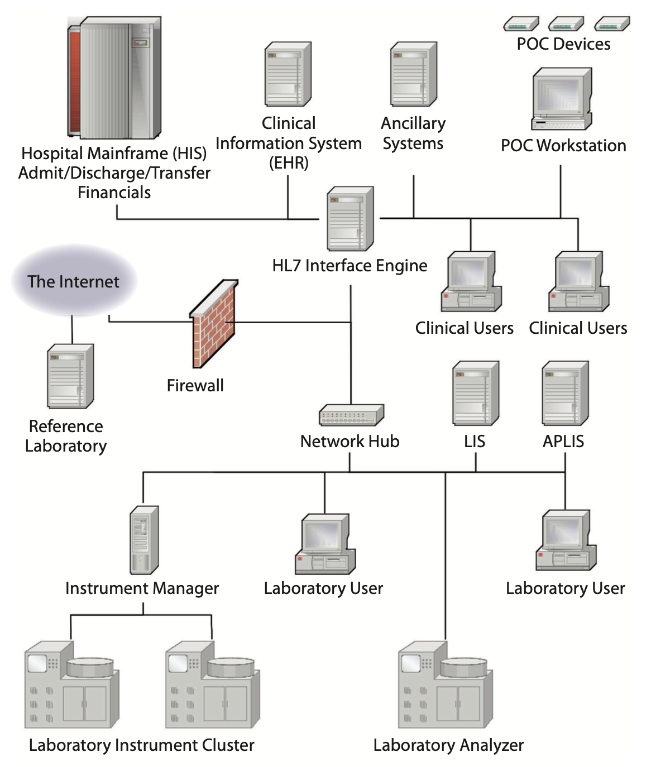
Network Security
Firewalls and routers restrict network traffic
Barrier between computer or network and outside
Barriers between network segments (partitions)
Diverse data travels on network
Encrypted communications from trusted clients can access network through virtual private network (VPN)

Slide 57
Only use approved cloud resources
UW Medicine must have a business associates agreement (BAA) in place with any non health care organization (non covered entity) that is managing/storing PHI
BAA is in place with:
Microsoft (Office 365, Teams, Azure)
Amazon (Amazon Web Services)
Coordinate with DLMP informatics for any planned use of cloud infrastructure outside of Office 365 & Teams
No BAA in place with Google (upper campus phasing out some but not all services)
Be cautious with all external web resources

Slide 58
Use the necessary technical tools to protect data
PCISA: I will not change my computer configuration or perform any action that might circumvent authentication or security on any UW Medicine system without prior approval.
PCISA: I will use only licensed and authorized software; I will not download, install or run unlicensed or unauthorized software.
Workstations by default do not include administrative privileges
Send software requests to labmedhelp@uw.edu
DLMP has scientific computing resources for data analysis activities, including RStudio which is accessible via web browser

Slide 59
Lesson Goals
Understand the considerations and limitations of laboratory data requests
Use local resources to develop and complete a data request
Lesson Objectives
Describe the common stages of completing a data request
List the minimum requirements for a good data request
Formulate a data request for an analysis project
Notes:
In the second session we will learn some fundamentals of coding including using functions, creating objects, and importing data.

Slide 60
Acknowledgements
Michelle Stoffel, University of Minnesota, for authoring general content
Association for Diagnostics and Laboratory Medicine – content developed for data science certificate program

